Slide 1




Recommender System on Amazon Game data

Slide 2




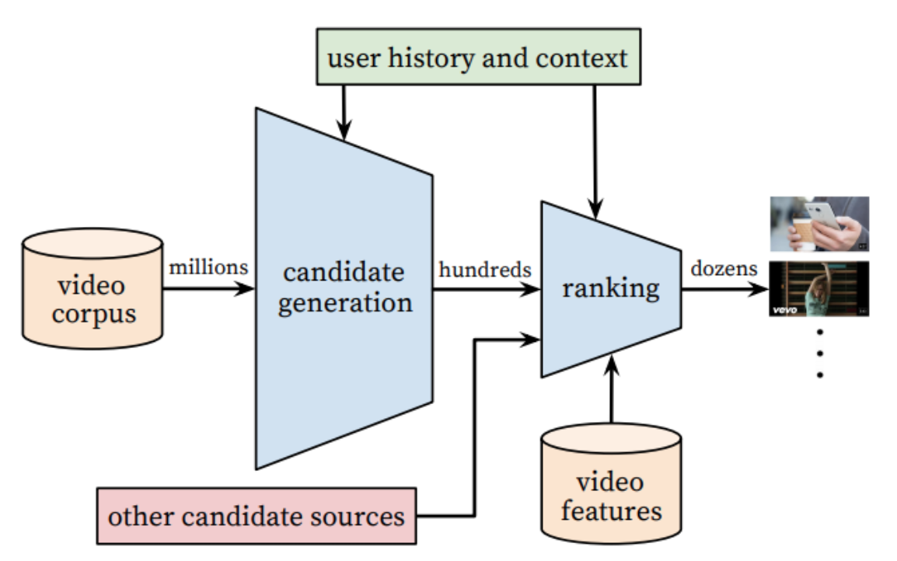









Problems

Slide 3

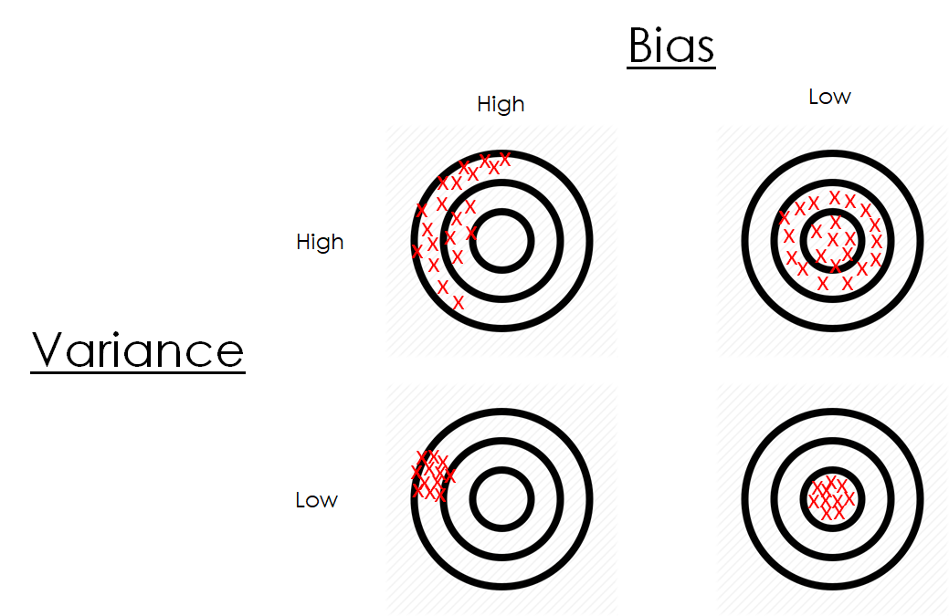









Steps
Test Data
Data Wrangling /
Data Merging
Exploratory Data Analysis / Feature Engineering
Modeling and
Training / Testing
Evaluation of Models
Prediction
Good
Bad
Tuning
Model 1 Model 2 …
Recommender System
Data
Training: ~1048K questions
Test: ~ 376K questions
Recommender System
Cleansed Data
Combined dataset: 1024K questions
Data (Training data development)
Training: ~717K questions
Test: ~307K questions

Slide 4
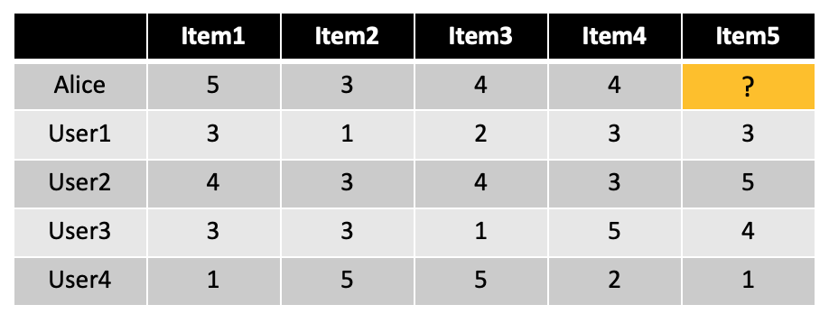


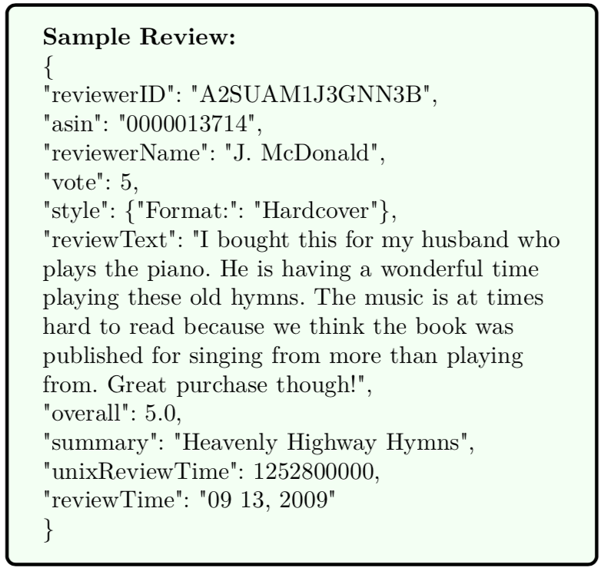
Data Wrangling
User-Item Matrix
Data Extraction:
5 years valid data (2014 – 2018)
Filtering out the reviews of non-purchasers
Data Imputation
Data Type Conversion
Metadata
Ratings
Merged Data:
Total Rows: ~2.56 million
# of Users: ~72,000,
# of Items: ~1.54 million
Cleaned Data:
Total Rows: ~49,535
# of Users: ~23,789,
# of Items: 241

Slide 5
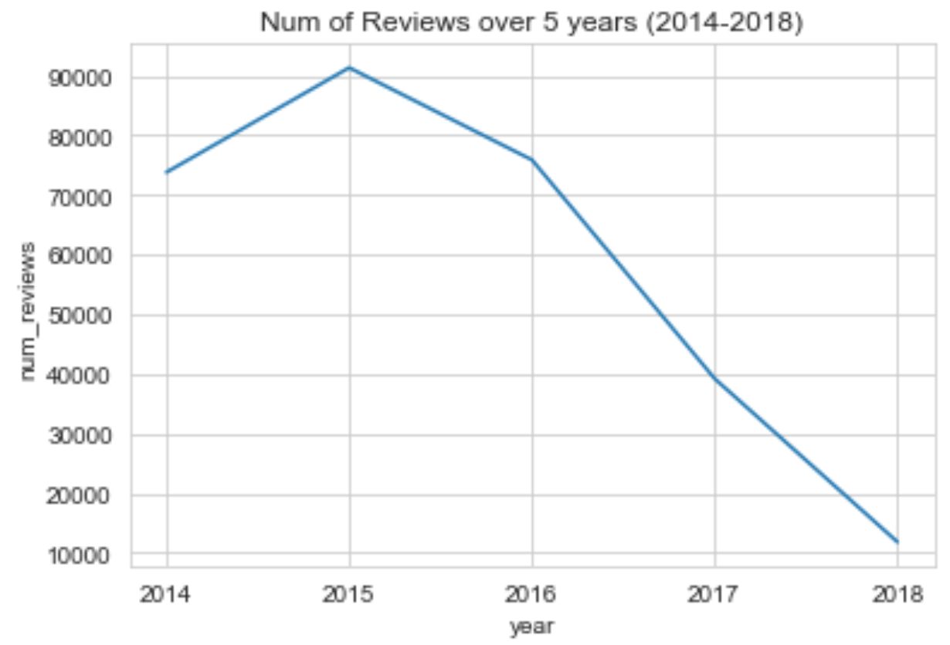
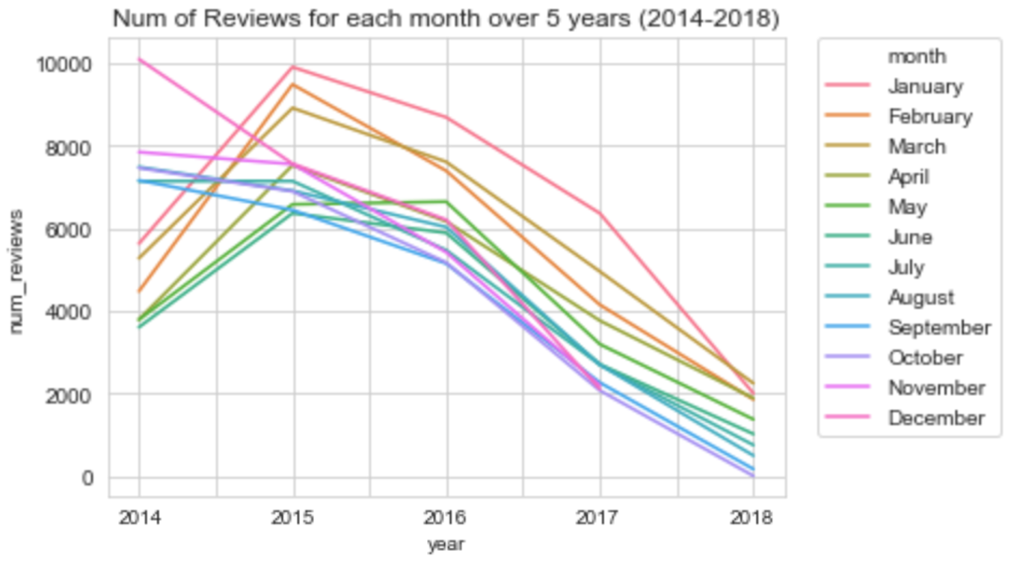
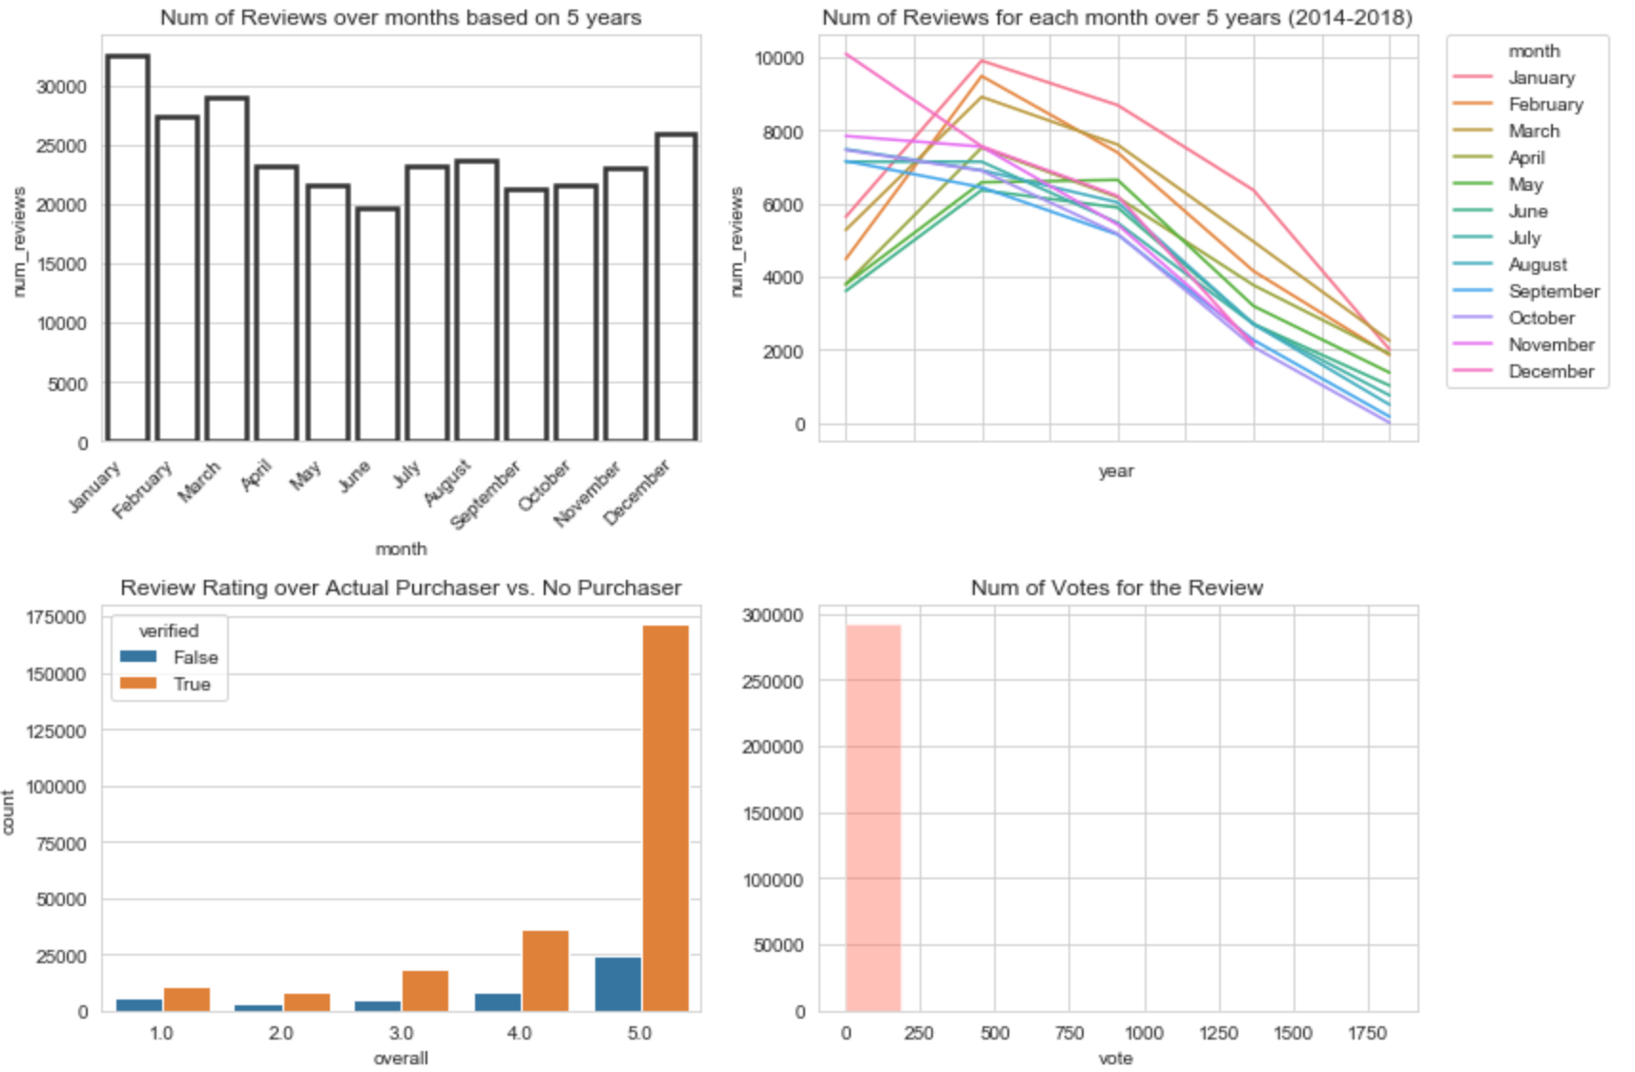
EDA

Slide 6
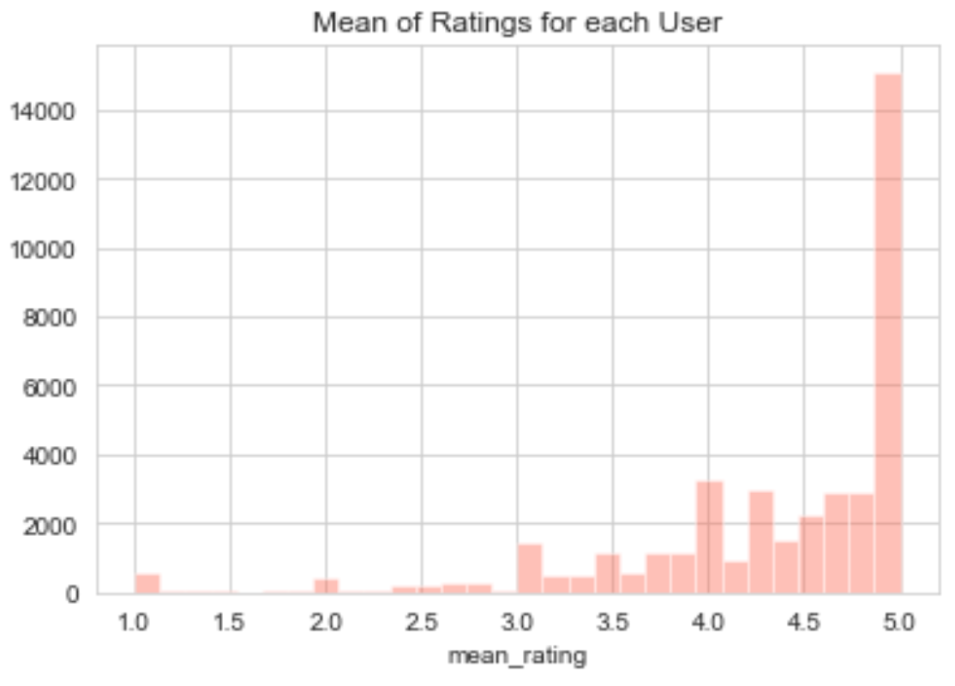
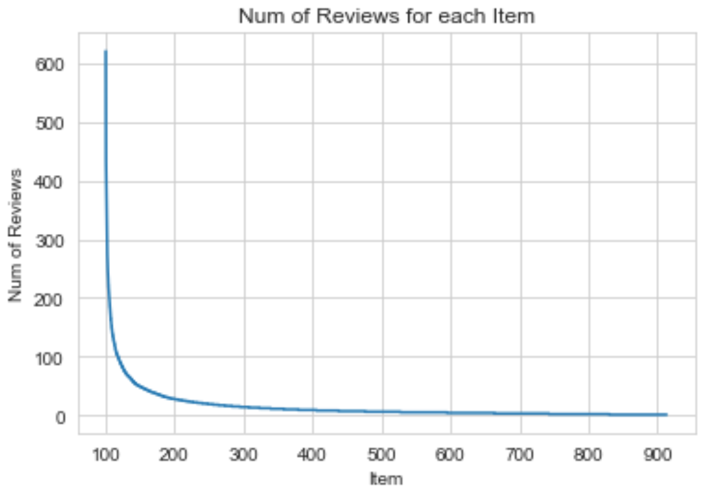
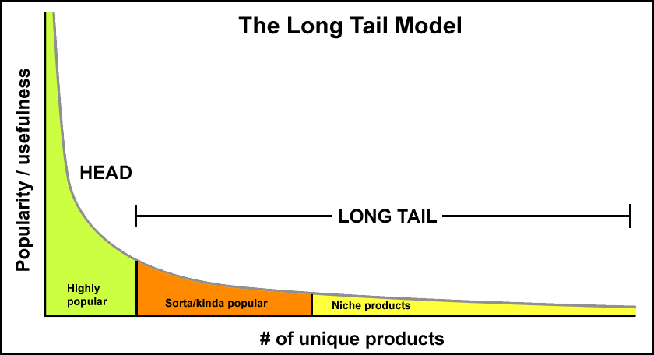
EDA
Top 20% cut

Slide 7
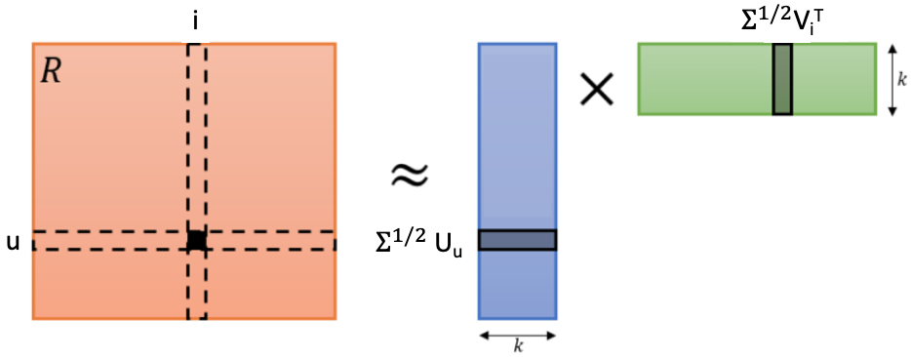
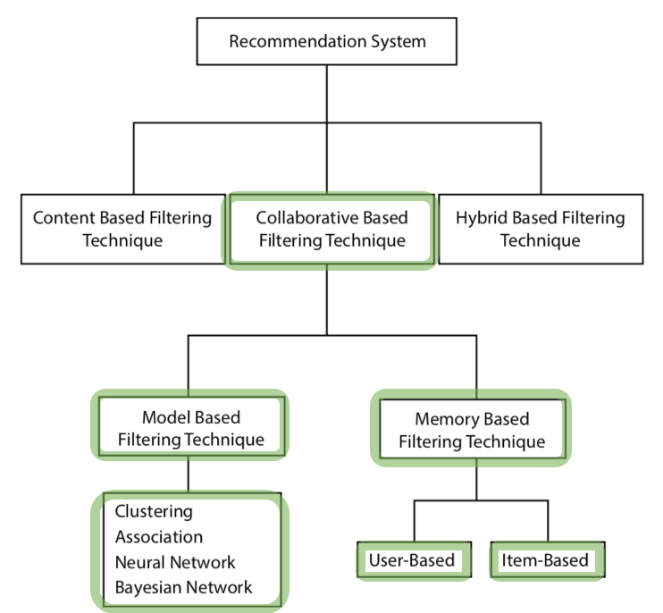
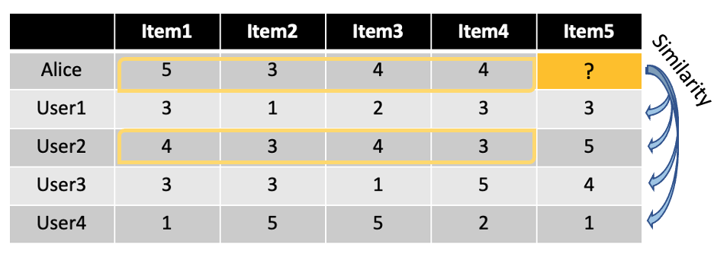
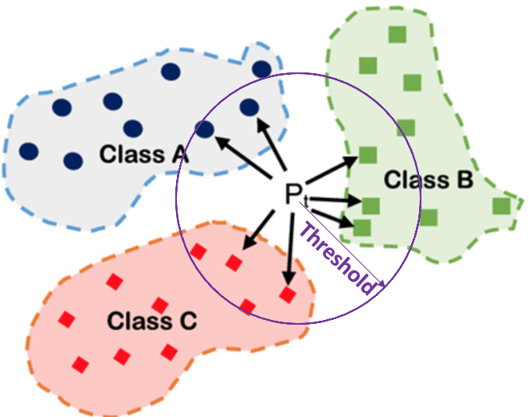
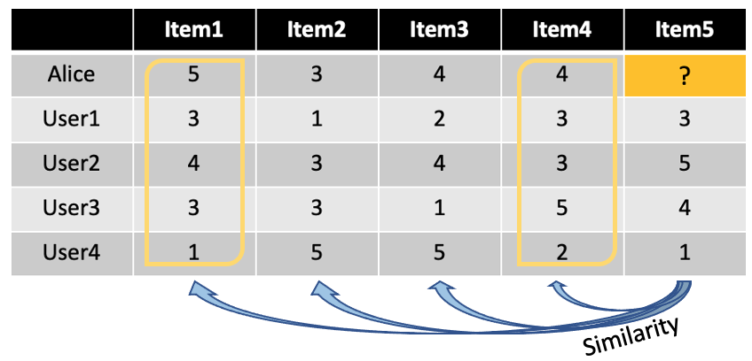
Model-based:
Matrix Factorization
Modeling
Recommender System Types
Item-latent
Models that I used for the project
User-Item Matrix
User-latent
Memory-based:
KNN

Slide 8
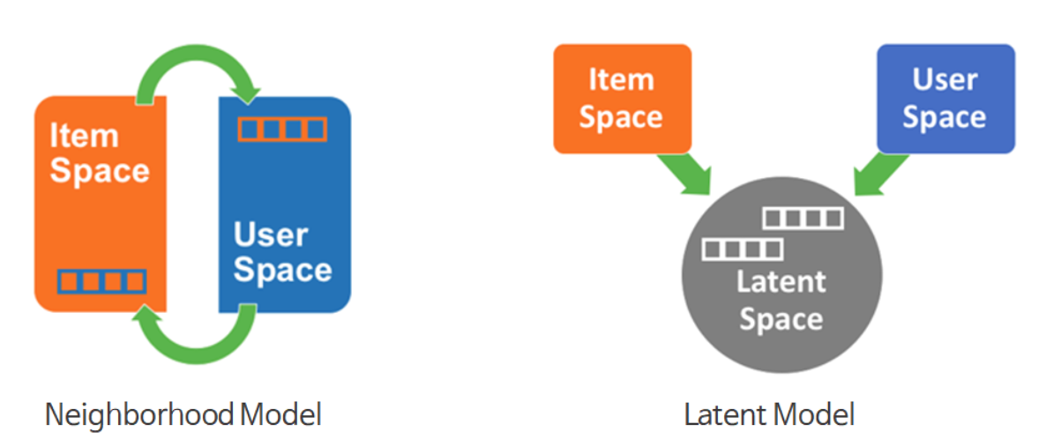
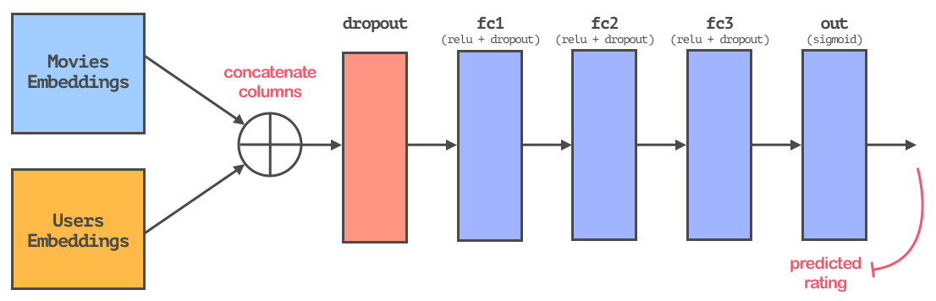
Modeling
Content-based Filtering
Hybrid Filtering
Model-based CF
Memory-based CF
Deep Learning based Recommender System
Neural Matrix Factorization 1
Neural Matrix Factorization 2
Neural Matrix Factorization 3
SVD
SVD++
NMF
KNN
KNN with Means
KNN with Z-score

Slide 9
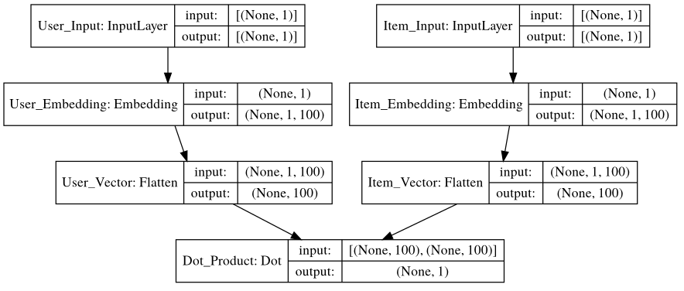
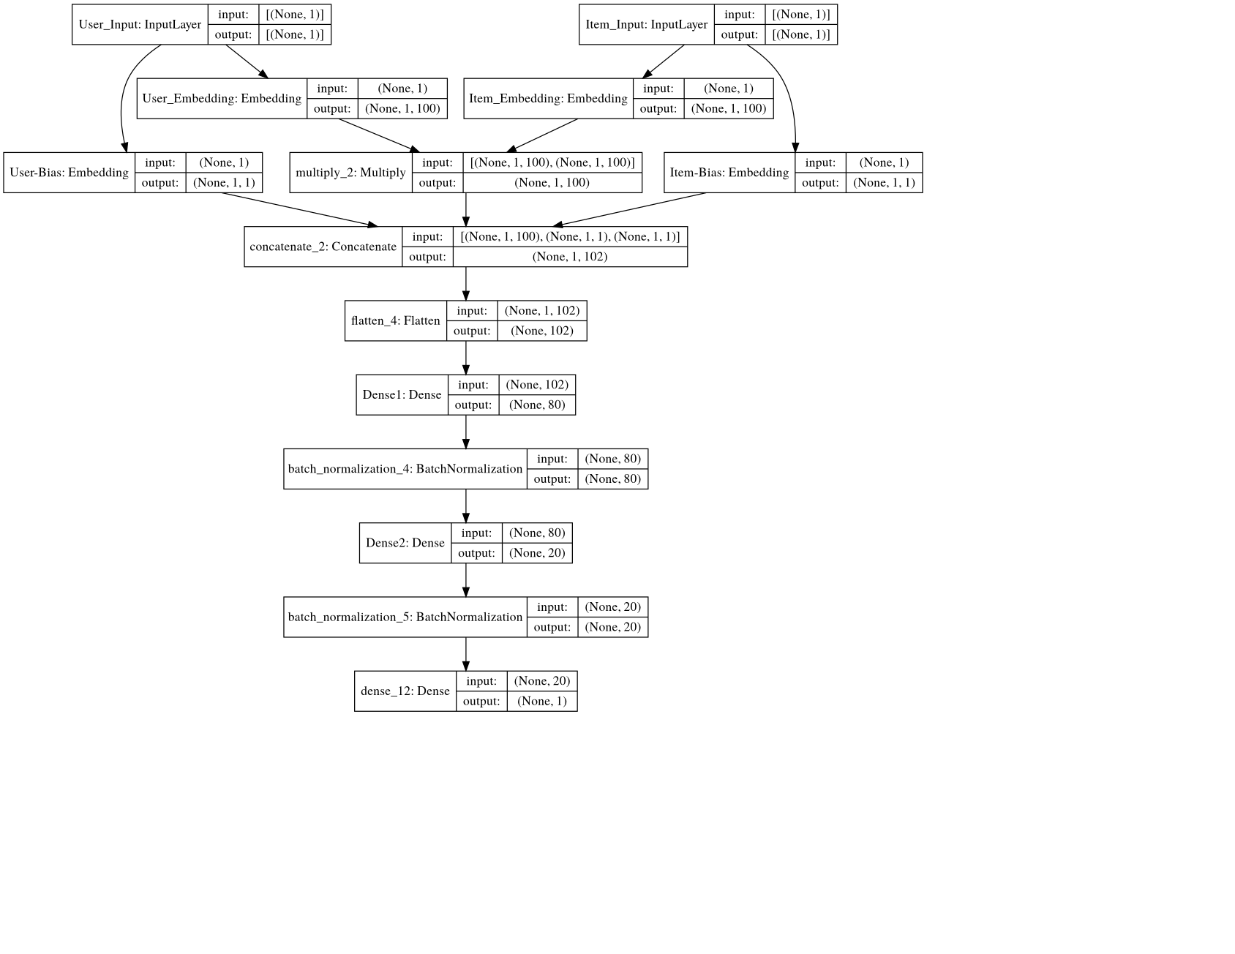
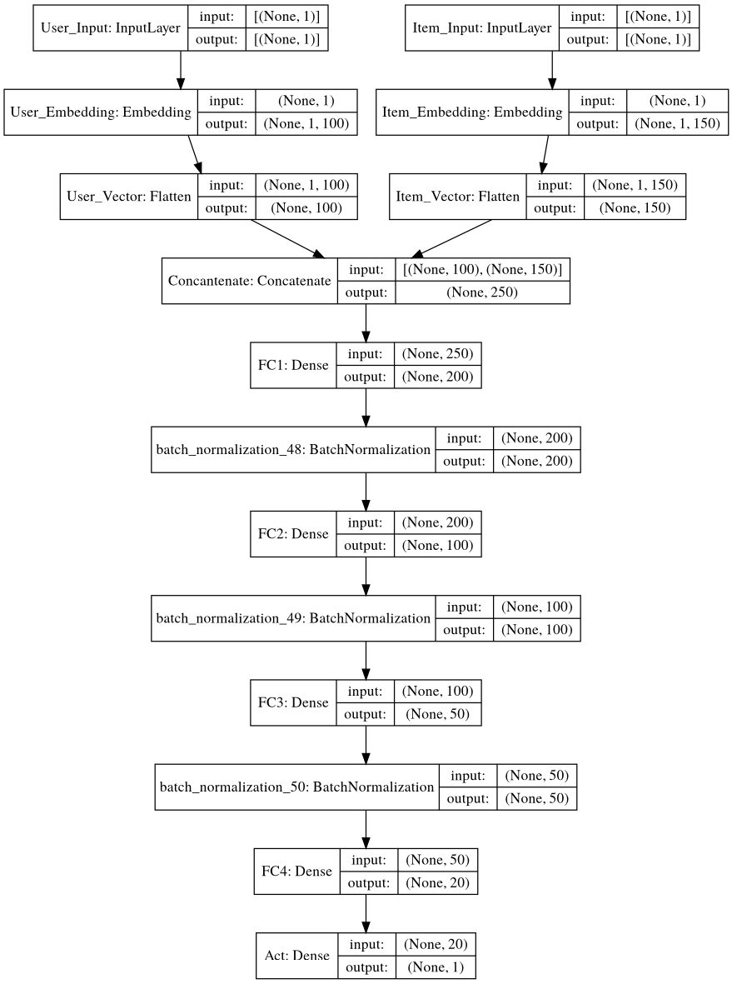
N-MF1
(Neural-Matrix
Factorization)
Modeling
N-MF2
N-MF3

Slide 10
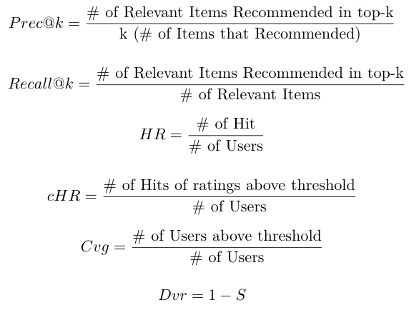
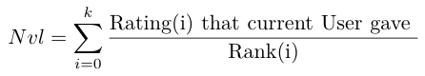
Evaluation of Models
Model Evaluation Metrics
RMSE: Root Mean Squared Error. Lower value is better.
MAE: Mean Absolute Error. Lower value is better.
Precision@k: number of recommended items that are actually rated within top-k over number of top-k. Higher value is better.
Recall@k: number of recommended items that are relevant over number of recommended items. Higher value is better.
HR: Hit Rate; how often we are able to recommend a left-out rating. Higher is better.
cHR: Cumulative Hit Rate; hit rate, confined to ratings above a certain threshold. Higher is better.
Coverage: Ratio of users for whom recommendations above a certain threshold exist. Higher is better.
Diversity:1−S, where Sis the average similarity score between every possible pair of recommendations for a given user. Higher means more diverse.
Novelty: Average popularity rank of recommended items. Higher means more novel.

Slide 11
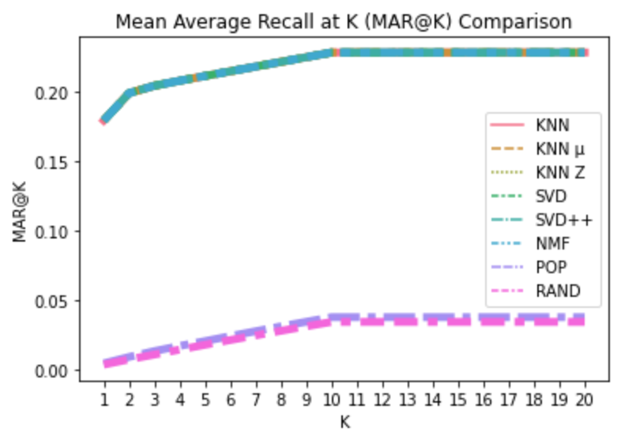
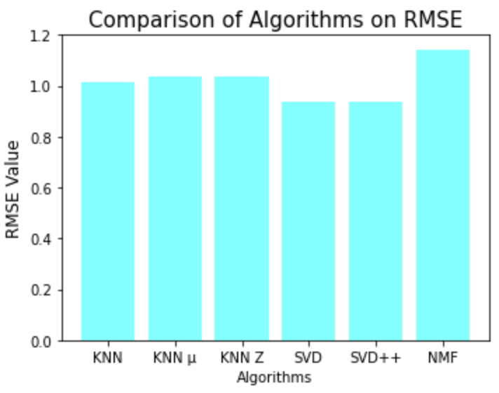
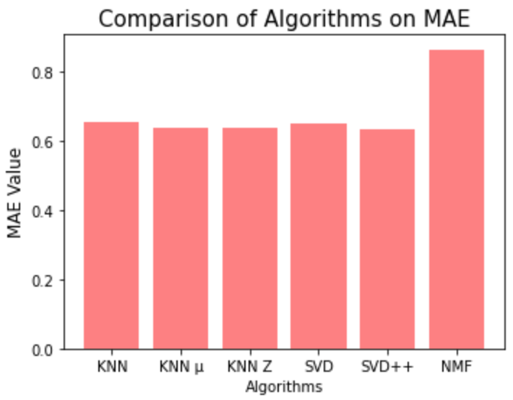
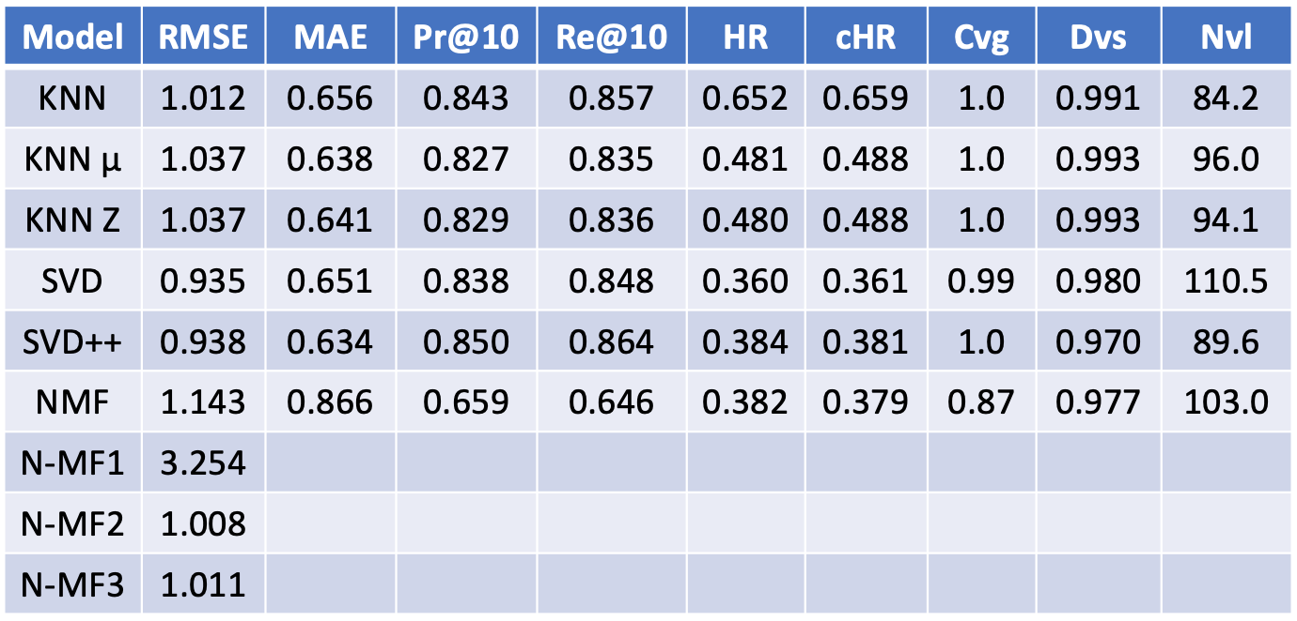
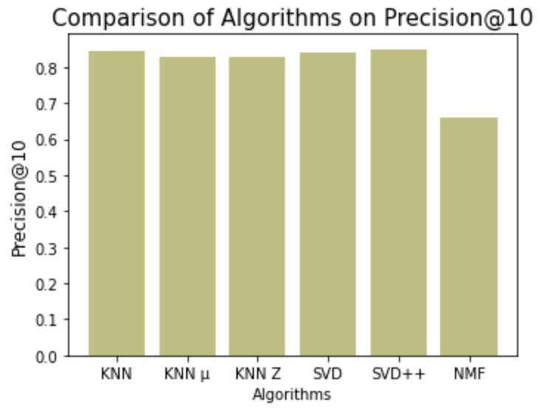
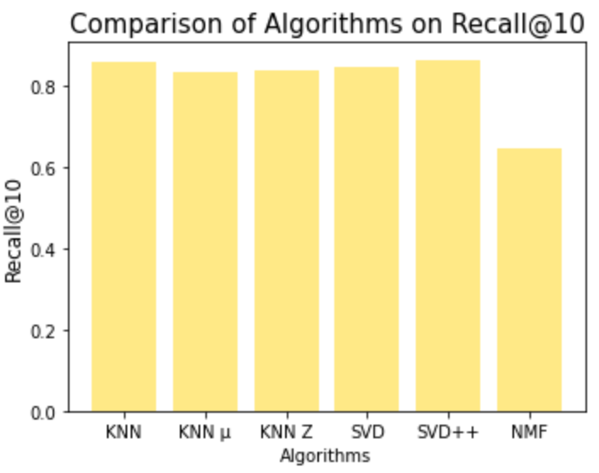
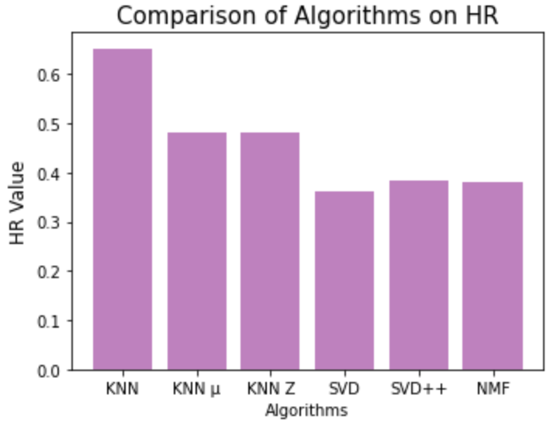
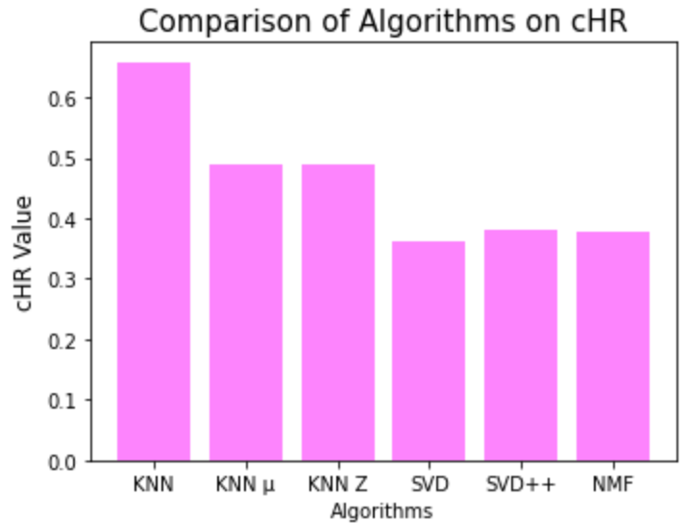
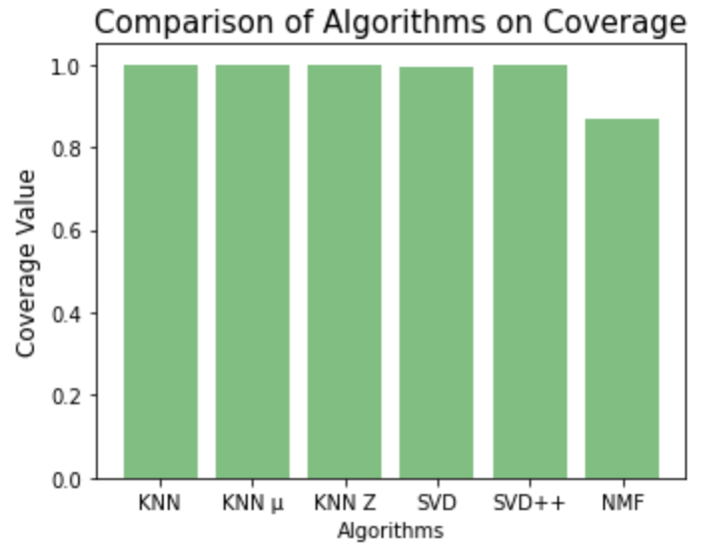
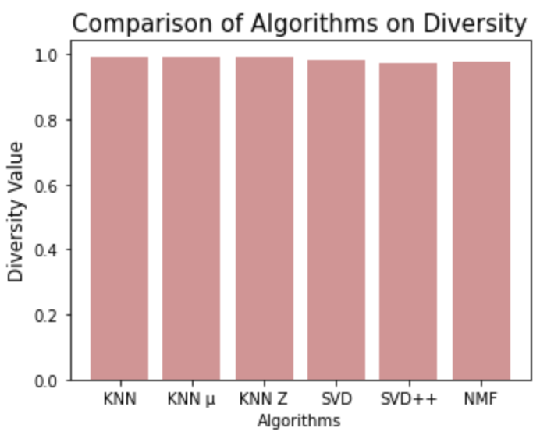
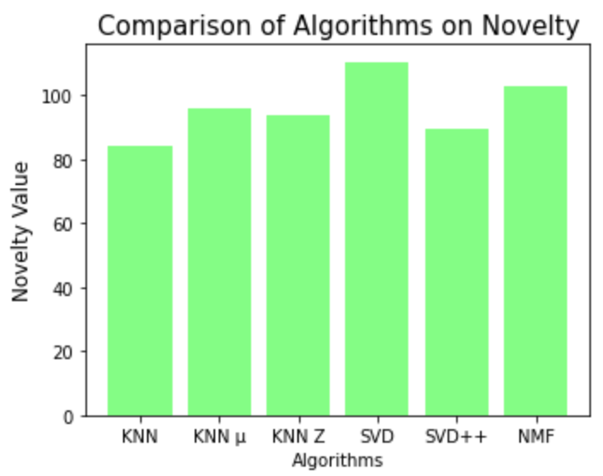
Evaluation of Models
Model Performance Comparison

Slide 12
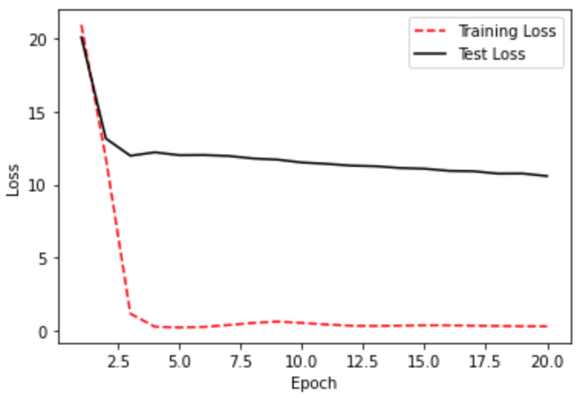
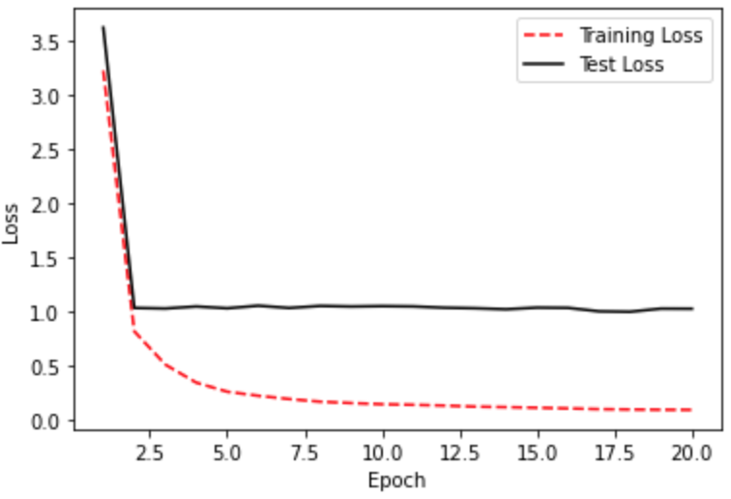
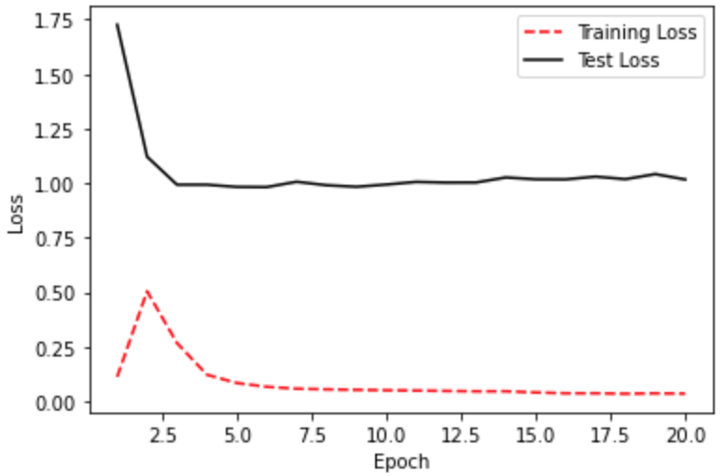
Evaluation of Models
Model Performance Comparison
Training Loss vs. Test Loss for N-MF1
Training Loss vs. Test Loss for N-MF3
Training Loss vs. Test Loss for N-MF2

Slide 13
Evaluation Metrics on Models
Model | RMSE | MAE | Pr@10 | Re@10 | HR | cHR | Cvg | Dvs | Nvl
KNN | 1.012 | 0.656 | 0.843 | 0.857 | 0.652 | 0.659 | 1.0 | 0.991 | 84.2
KNN μ | 1.037 | 0.638 | 0.827 | 0.835 | 0.481 | 0.488 | 1.0 | 0.993 | 96.0
KNN Z | 1.037 | 0.641 | 0.829 | 0.836 | 0.480 | 0.488 | 1.0 | 0.993 | 94.1
SVD | 0.935 | 0.651 | 0.838 | 0.848 | 0.360 | 0.361 | 0.99 | 0.980 | 110.5
SVD++ | 0.938 | 0.634 | 0.850 | 0.864 | 0.384 | 0.381 | 1.0 | 0.970 | 89.6
NMF | 1.143 | 0.866 | 0.659 | 0.646 | 0.382 | 0.379 | 0.87 | 0.977 | 103.0
N-MF1 | 3.254
N-MF2 | 1.008
N-MF3 | 1.011

Slide 15
Modeling
Models that I used for the project
Recommender System Types

Slide 16
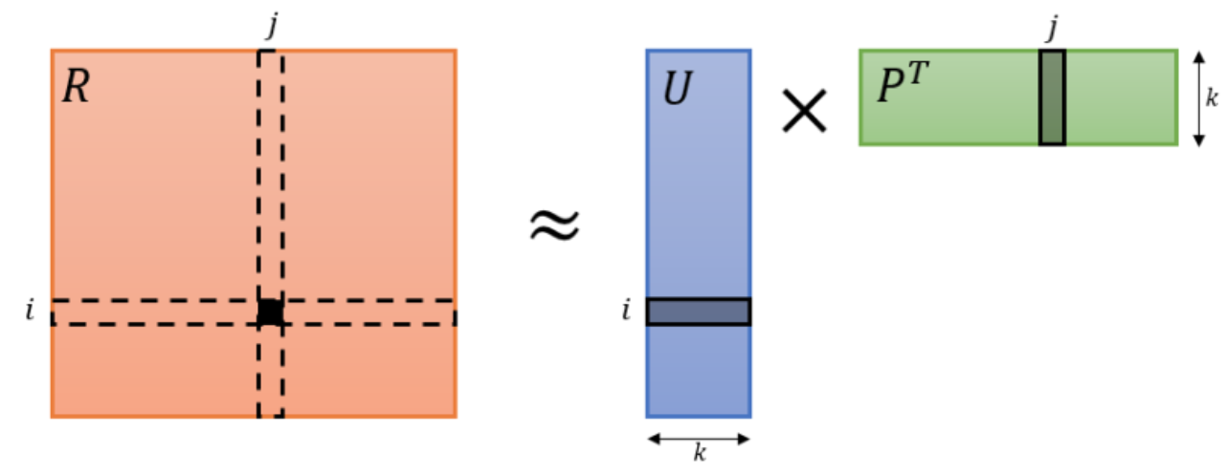


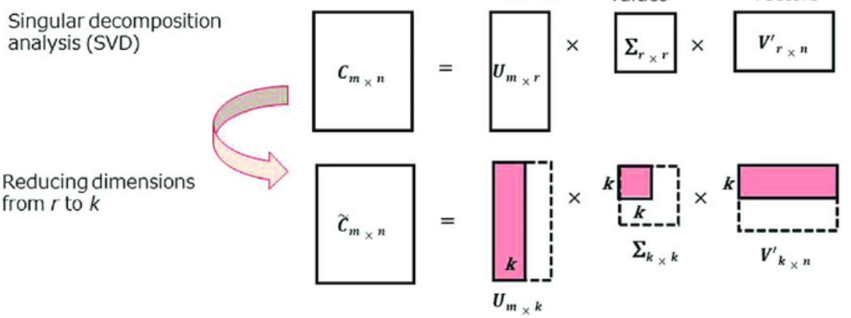
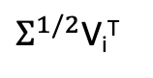
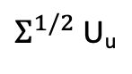
i
$Σ^{1/2}$V_{i}^{T}
i
u
$Σ^{1/2}$U_{u}
R _{m x n}
R _{m x n}

Slide 17
Similarity

Slide 18

Similarity

Slide 19
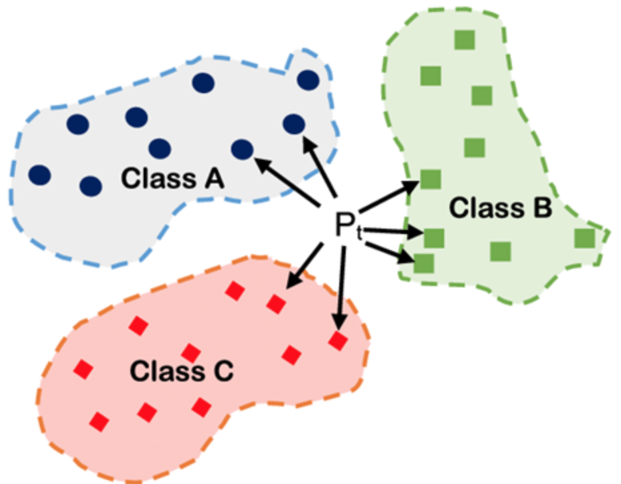
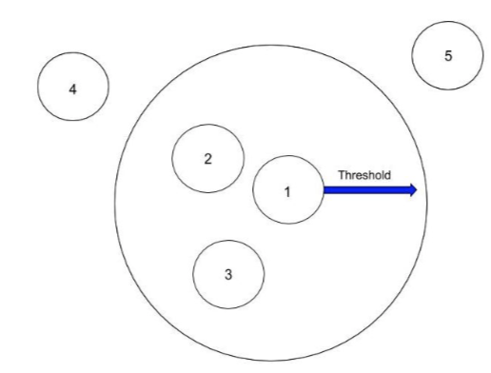
Threshold

Slide 20
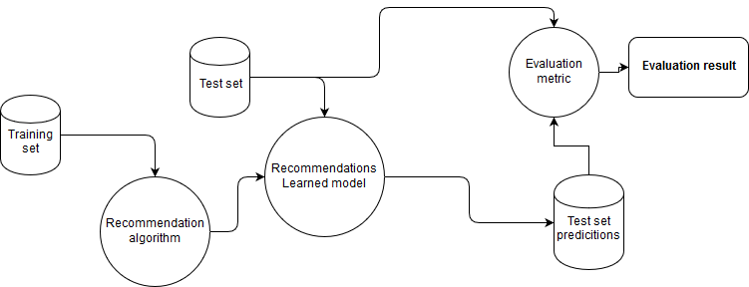

Slide 26
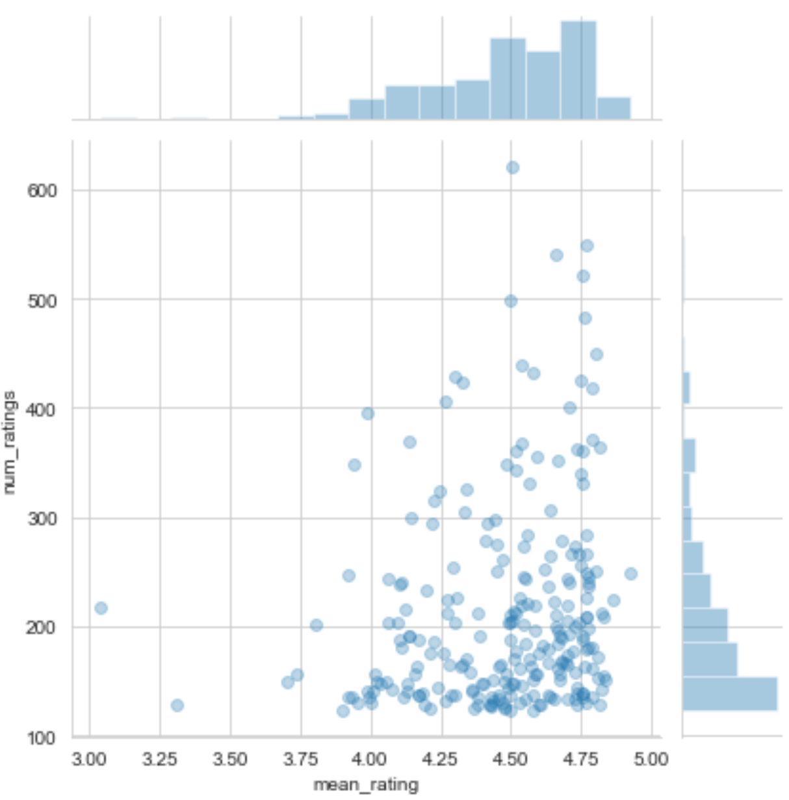

Slide 27
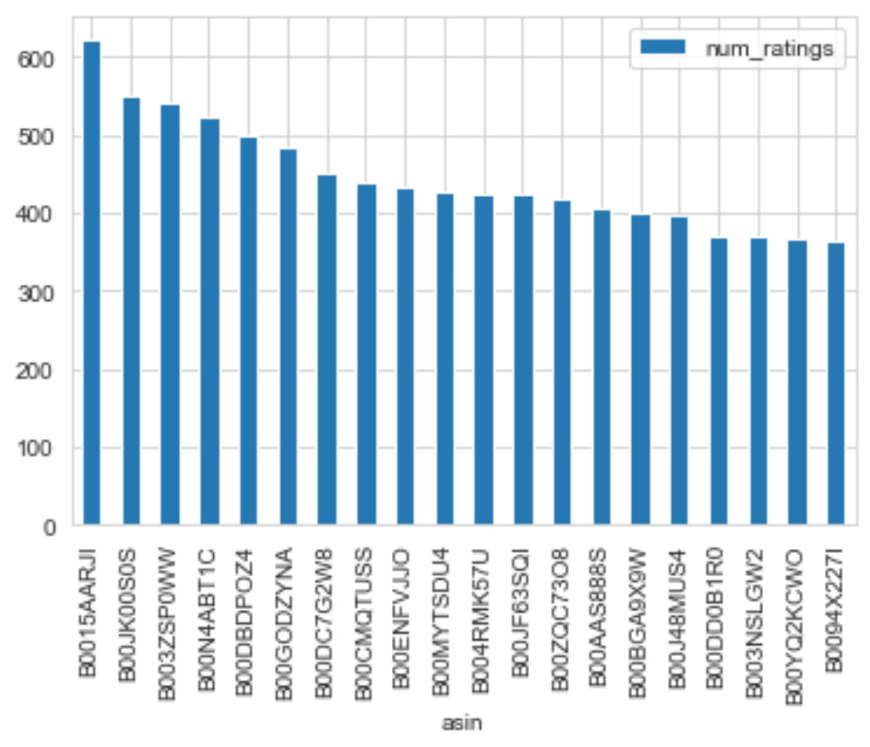

Slide 29
Model | RMSE | MAE | Pr@10 | Re@10 | HR | cHR | Cvg | Dvs | Nvl
KNN | 1.012 | 0.656 | 0.843 | 0.857 | 0.652 | 0.659 | 1.0 | 0.991 | 84.2
KNN μ | 1.037 | 0.638 | 0.827 | 0.835 | 0.481 | 0.488 | 1.0 | 0.993 | 96.0
KNN Z | 1.037 | 0.641 | 0.829 | 0.836 | 0.480 | 0.488 | 1.0 | 0.993 | 94.1
SVD | 0.935 | 0.651 | 0.838 | 0.848 | 0.360 | 0.361 | 0.99 | 0.980 | 110.5
SVD++ | 0.938 | 0.634 | 0.850 | 0.864 | 0.384 | 0.381 | 1.0 | 0.970 | 89.6
NMF | 1.143 | 0.866 | 0.659 | 0.646 | 0.382 | 0.379 | 0.87 | 0.977 | 103.0
N-MF1
N-MF2
N-MF3

